Slide 1
How to do an advanced search in PharmaPendium?
Retrieving information from PharmaPendium
Marnix Wieffer, Senior marketing manager
Notes:
Hello everybody and welcome to this training video, where I will show you how to do a quick search in PharmaPEndium

Slide 2
Learning objective
Why an advanced search?
Building an advanced search
Limit your search by:
  Drug name/class
  Target name/class
  Sources
At the end of this video you should have a good understanding how to use the advanced text search function.
This should enable your to retrieve relevant insights from the full text from regulatory documents with high signal to noise
Notes:
During this training session I will first show you a basic quick search example, then I will show you how to enrich your search wildcard, Exact phrase searches and Boolean operators
At the end of this video you should have a good understanding how to use the quick search function.
Enable you to retrieve data relevant for you using quick search

Slide 3
Why advanced searching?
The quick search bar has limited pre-search limiting options
Maybe your would o limited your search to a specific drug class, source or target
Increasing the signal-to-noise of your results
Recommended: Quick search tutorial video
https://service.elsevier.com/app/answers/detail/a_id/5198/supporthub/pharmapendium/kw/Quick+search/
Notes:
Using the Quick search feature we can search the PharmaPendium document base in full text. These include FDA approval packages, EMA approval packages, FDA advisory committee meeting documents, DESI document, Meyler’s abd Mosby’s drug consult. Now, especially FDA regulatory documents are often scanned image files and finding relevant information is notoriously hard. We have made all those documents text searchable and we can discover relevant content easily using quick search. For example, we can ask ourselves the question, what FDA advisory committee meeting document specifically

Slide 4
Advanced search example question
  I am developing a new drug and considering using Enteric coating. What regulatory concerns could I anticipate around the safety of this coating?
Notes:
Using the Quick search feature we can search the PharmaPendium document base in full text. These include FDA approval packages, EMA approval packages, FDA advisory committee meeting documents, DESI document, Meyler’s abd Mosby’s drug consult. Now, especially FDA regulatory documents are often scanned image files and finding relevant information is notoriously hard. We have made all those documents text searchable and we can discover relevant content easily using quick search. For example, we can ask ourselves the question, what FDA advisory committee meeting document specifically

Slide 5
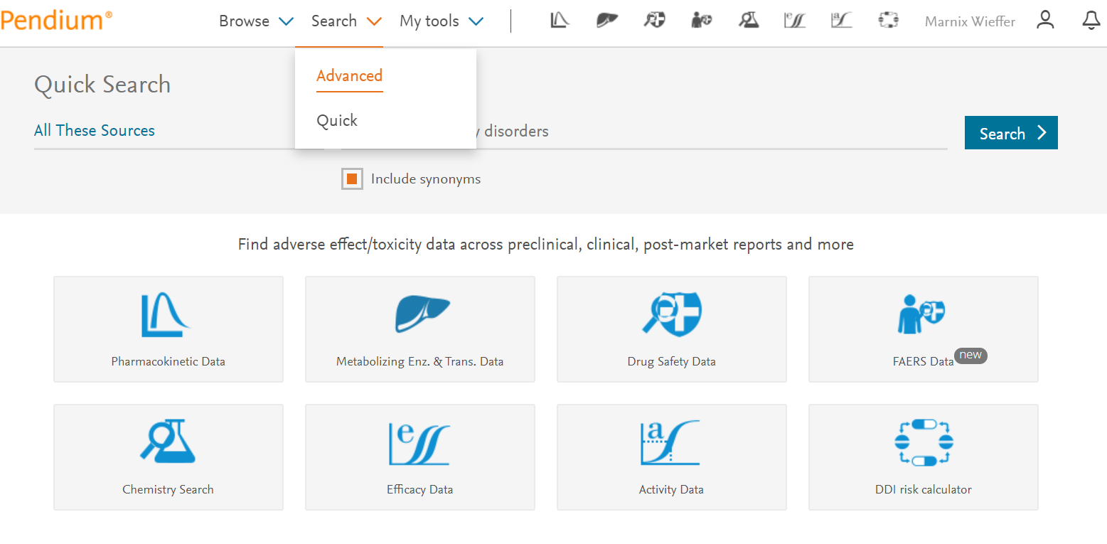
Starting and advanced searches
Notes:
Using the Quick search feature we can search the PharmaPendium document base in full text. These include FDA approval packages, EMA approval packages, FDA advisory committee meeting documents, DESI document, Meyler’s abd Mosby’s drug consult. Now, especially FDA regulatory documents are often scanned image files and finding relevant information is notoriously hard. We have made all those documents text searchable and we can discover relevant content easily using quick search. For example, we can ask ourselves the question, what FDA advisory committee meeting document specifically

Slide 6
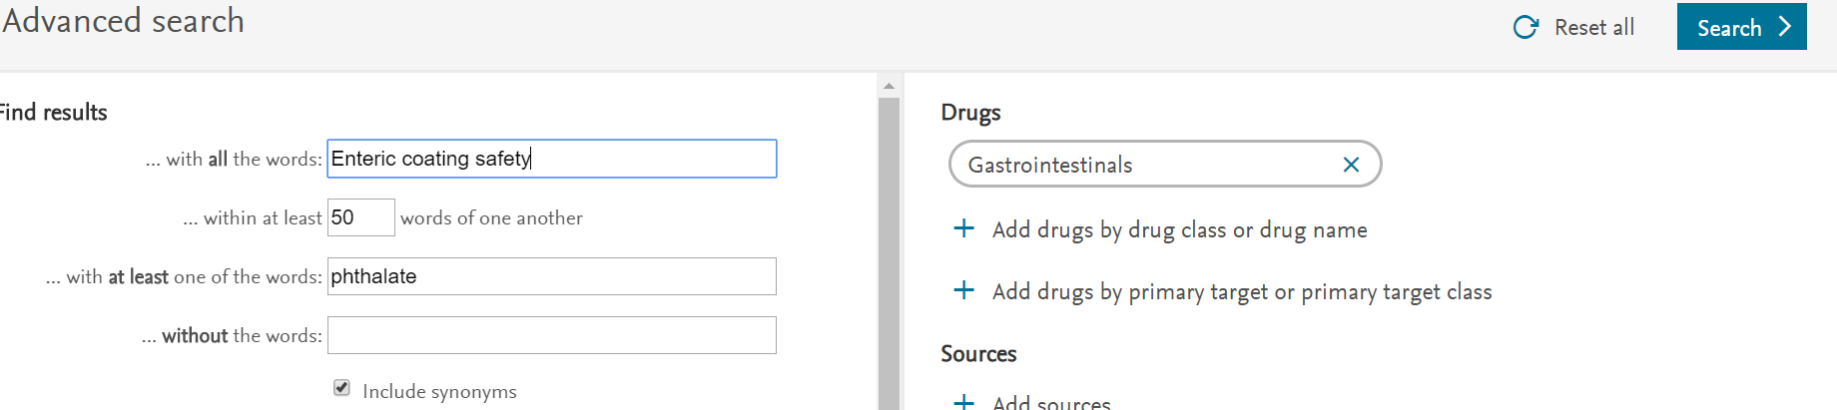
Starting and advanced searches
1. Proximity terms are searched using the NEAR operator. The proximity search does not search for synonyms but Wildcards (* or ?) can be used here.
2. Additional terms can be added using the AND operator. Synonyms can be searched on entries in this field. Wildcards (* or ?) can be used here
4. Search can be limited on drug, drug class, target, target class and sources
3. Additional terms can be added using the NOT operator. Synonyms can be searched on entries in this field. Wildcards (* or ?) can be used here
Notes:
Importantly, the Advanced search function is a form that helps you to build a complex search query.
The number at the end (distance) is how close in the document you want all the words or phrases to be. The maximum distance for this search is 200 words.
The proximity search does NOT search for synonyms but Wildcards (* or ?) can be used here.
(Proximity terms (1st field) are searched using the NEAR operator)
In the second field you can enter single words. All terms entered here will be searched as an OR search. All punctuation symbols are ignored. Synonyms can be searched on entries in this field.
Wildcards (* or ?) can be used here. Quick Search syntax example: AND (term1 OR term2 OR ... OR termN)
Proximity Searches can also be done on the Quick Search bar using the syntax [term1, term2, ..., termN = Distance]

Slide 7
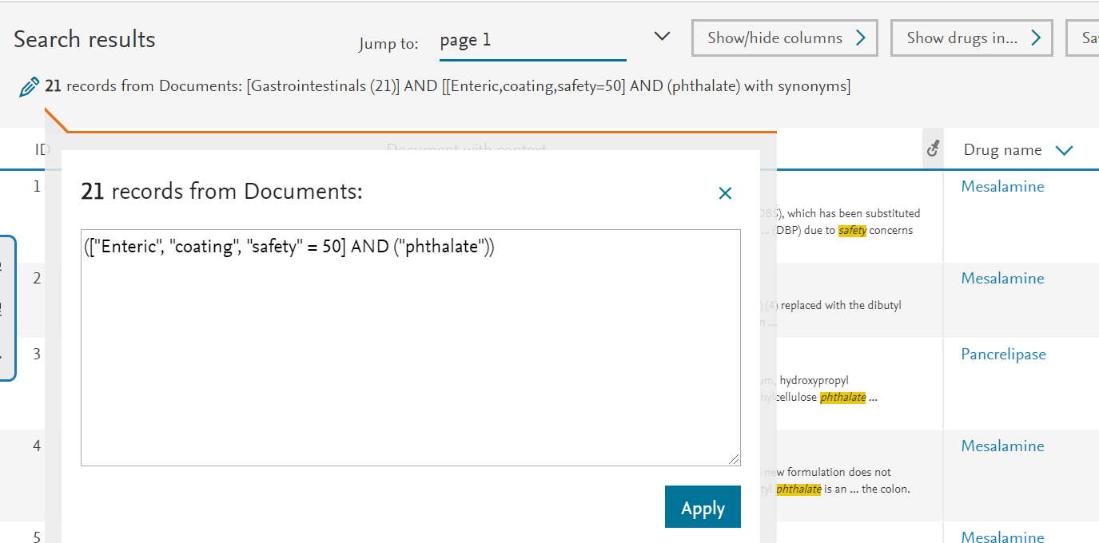
Original query code can be modified
Notes:
Importantly, the Advanced search function is a form that helps you to build a complex search query.
The number at the end (distance) is how close in the document you want all the words or phrases to be. The maximum distance for this search is 200 words.
The proximity search does NOT search for synonyms but Wildcards (* or ?) can be used here.
(Proximity terms (1st field) are searched using the NEAR operator)
In the second field you can enter single words. All terms entered here will be searched as an OR search. All punctuation symbols are ignored. Synonyms can be searched on entries in this field.
Wildcards (* or ?) can be used here. Quick Search syntax example: AND (term1 OR term2 OR ... OR termN)
Proximity Searches can also be done on the Quick Search bar using the syntax [term1, term2, ..., termN = Distance]

Slide 8
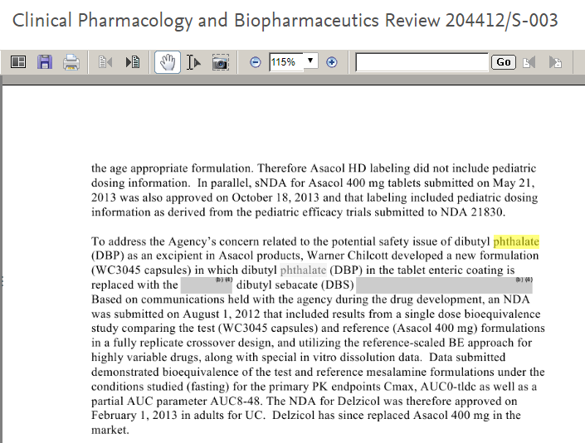
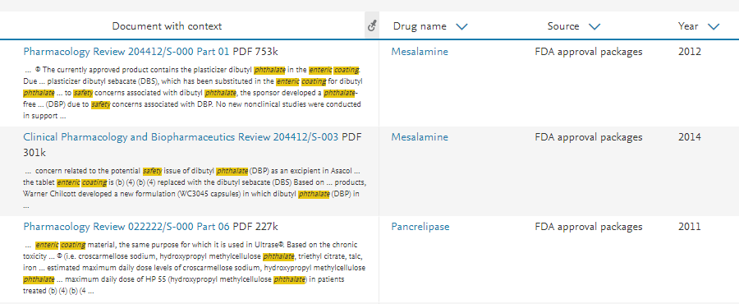
Key regulatory insights
Use Dibutyl Sebacate instead of Dibutyl Phthalate!
Notes:
Importantly, the Advanced search function is a form that helps you to build a complex search query.
The number at the end (distance) is how close in the document you want all the words or phrases to be. The maximum distance for this search is 200 words.
The proximity search does NOT search for synonyms but Wildcards (* or ?) can be used here.
(Proximity terms (1st field) are searched using the NEAR operator)
In the second field you can enter single words. All terms entered here will be searched as an OR search. All punctuation symbols are ignored. Synonyms can be searched on entries in this field.
Wildcards (* or ?) can be used here. Quick Search syntax example: AND (term1 OR term2 OR ... OR termN)
Proximity Searches can also be done on the Quick Search bar using the syntax [term1, term2, ..., termN = Distance]

Slide 9
Notes:
With that I would like to thank you for your attention. I case of quetsions, please do not hesitate to get in touch.

